Slide 1
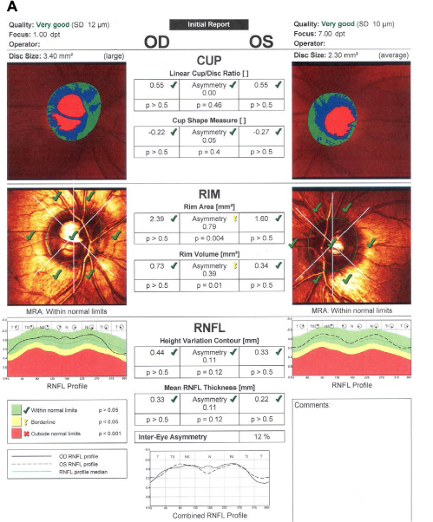
HEIDELBERG RETINAL TOMOGRAPHY BASED STUDY OF OPTIC DISC & RETINAL NERVE FIBRE LAYER IN PAEDIATRIC GLAUCOMA
Author: Dr.Nidhi Patel
Associate professor: Dr.Reema Raval
Assistant professor: Dr.kintu shah
CONCLUSION
HRT based study suggest that paediatric glaucoma mostly present in advanced stage of disease.
INTRODUCTION
RESULT
Childhood glaucoma also referred to as congenital glaucoma , paediatric or infantile glaucoma . It is usually diagnosed within 1st year of life. It is caused by incorrect development of the eye’s drainage system before the birth.
Out of the 31 children with diagnosed congenita glaucoma, 17 children had cup size between 0.70 mm to 0.80 mm with glaucoma probability score more than 85%. And mean RNFL thickness was reduced. Out of 31 children, 10 children having bilaterally cup size was between 0.70 mm to 0.90 mm. most of the children between the age of 8 to 14 years presented with cup size between 0.6 to 0.9 mm. The average of cup size and cup depth of RE is 0.85mm & 0.80mm respectively and in LE it is 0.77mm and 0.73mm respectively. According to the bar chart mentioned here most of children with 0.93mm cup size have age group of 15 to 16years.
TAKE HOME MESSAGE
Early comprehensive eye examination can reduce the national burden of paediatric blindness. School health programme including comprehensive eye check-up can also help to detect early diagnosis of paediatric glaucoma. Screening can aid in early detection ,referral and intervention.
AIM
To evaluate the severity of paediatric glaucoma on the basis of disc evaluation and retinal nerve fibre layer with the help of Heidelberg retinal tomography.
METHOD AND MATERIAL
LIMITATION
Small sample size
Study : Cross sectional
Sample size :31
Site: Tertiary care centre
The severity of glaucoma was studied on the basis of HRT parameters which were cup size , cup depth, glaucoma probability score , retinal nerve fibre layer thickness.
1. Harwerth RS, Carter-Dawson L, Shen F, Smith EL III Crawford ML. Ganglion cell losses underlying visual field defects from experimental glaucoma. Invest Ophthalmoogy Vis Sci. 1999;40:2242-2250.
2. Sommer A, Katz J, Quigley HA, et al. Clinically detectable nerve fiber atrophy precedes the onset of glaucomatous field loss. Arch Ophthalmology 1991;109:77-83.
REFERENCE

